Slide 1

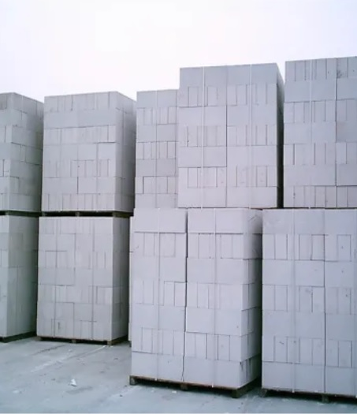

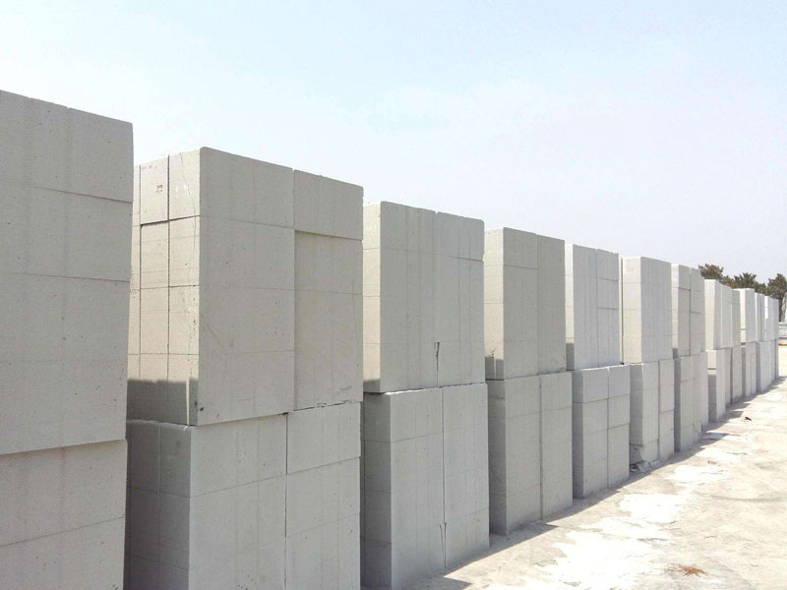
MONOTECH ENGINEERS PVT LTD.
AAC
BLOCKS
Leading Supplier in
Autoclave Aerated Concrete
Block Production Line

Slide 2
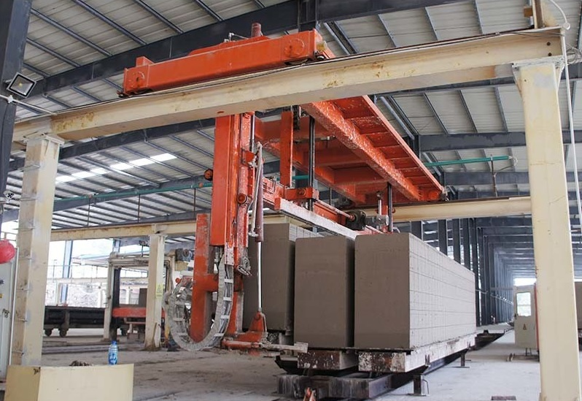
About Us
The Monotech Engineers Pvt Ltd started in 2007,
Corporate Address: S – 16, South Side, GT Road Industrial Area, Ghaziabad-201009. It an integral part of “The NS Energy Group” which is a Conglomerate of upcoming professionally managed companies engaged in Design, Manufacture, EPC and O&M of AAC Block Machine, Power Plants since last two decades.
The N S Energy Group Comprises of:-
1. N S Thermal Energy (P) Ltd. www.nsthermalenergy.com
2. N S Terbo (P) Ltd. www.nsterbo.com
3. Monotech Engineers (P) Ltd. www.monotech-engineers.com
4. Mithila Dying and Chemical (P) Ltd.www.mdc-pl.com
5. Neeraj Gupta & Sons (P) Ltd www.ng-sons.com

Slide 3
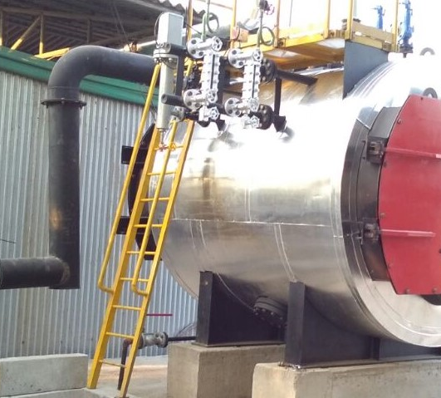
Product Description
AAC light weight Concrete Block Making Machine Line
We designs and manufactures AAC block making plant, to meet the specific requirements of the market and customers.
As a new building material, AAC block fulfills the demand of concrete industry, which requires to save the natural resources and protect the environment.
With Indigenous technology and our own R&D, we provide our customers state-the-art AAC block making plant.
Advantages:
AAC is becoming more and more popular around the world, from western countries and then to developing countries. Below Properties make AAC have unmatchable property, especially for high buildings:
1) Extreme Light Weight
2) Large Variety of Sizes
3) High Fire Resistant
4) Excellent Thermal Insulation
5) Great Sound Insulation
6) Moisture Protection
7) Termite Resistant
8) High Workability and Easy Processing

Slide 4
Our Promise
Monotech AAC Block Machine
MISSION STATEMENT
Our aim to becoming a leading Supplier and manufacturer of AAC Blocks making machine in India, and committed to present a complete system backed up by professional skilled technical support with excellent customer service.
We manufacture high quality and cost effective AAC machines which adds value to our customers.
We work with reliability and respect. We are continuously driven towards the improvement of our environmental performance.

Slide 5
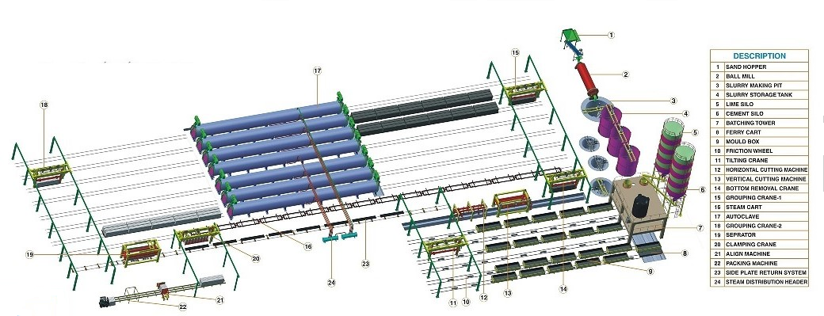
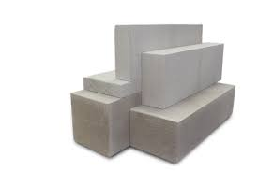
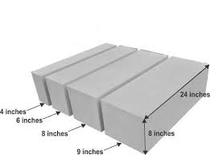
AAC BLOCK PLANT DETAILS

Slide 6
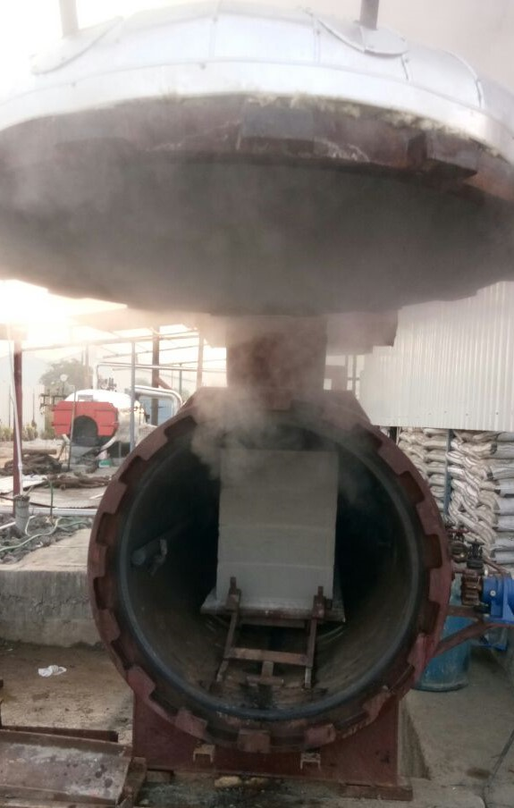
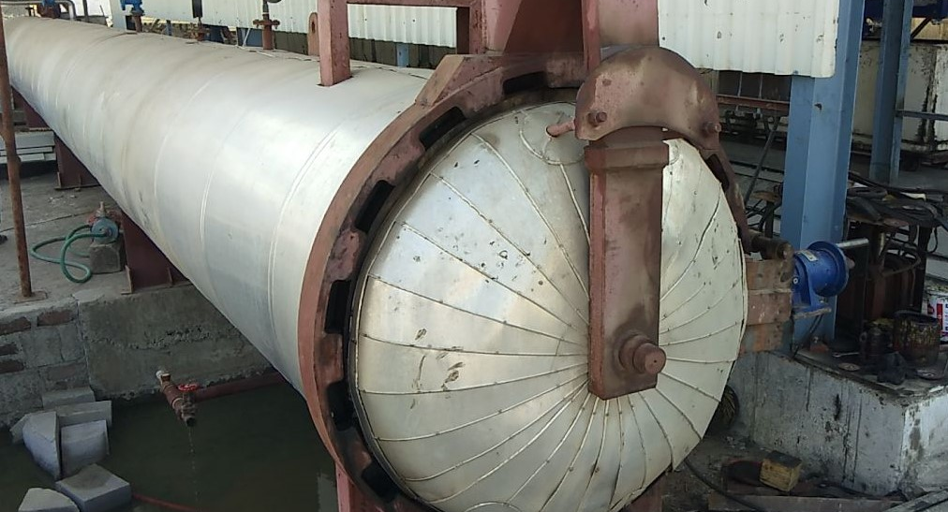
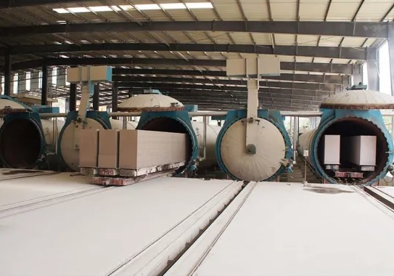
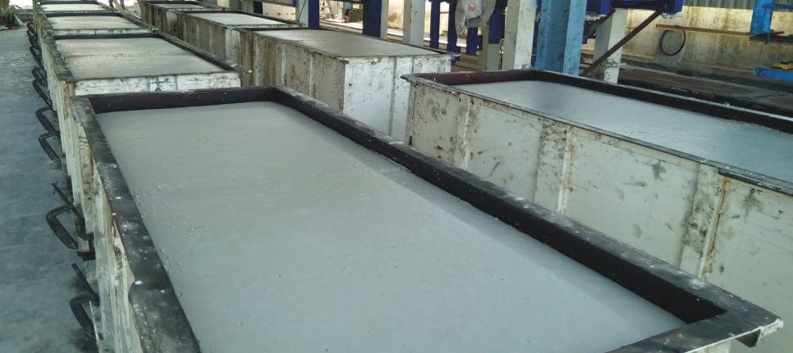
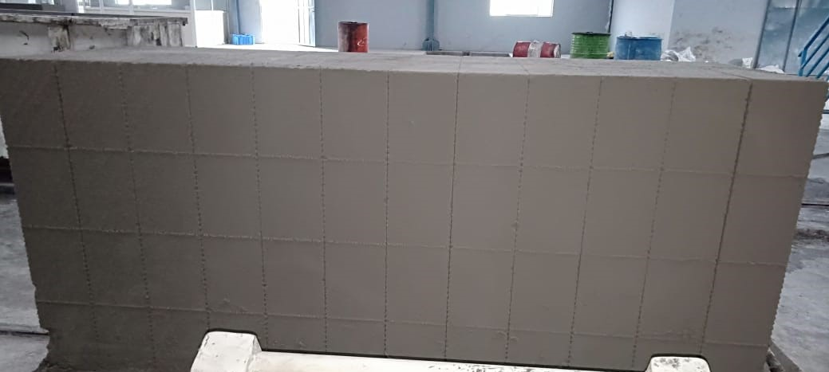
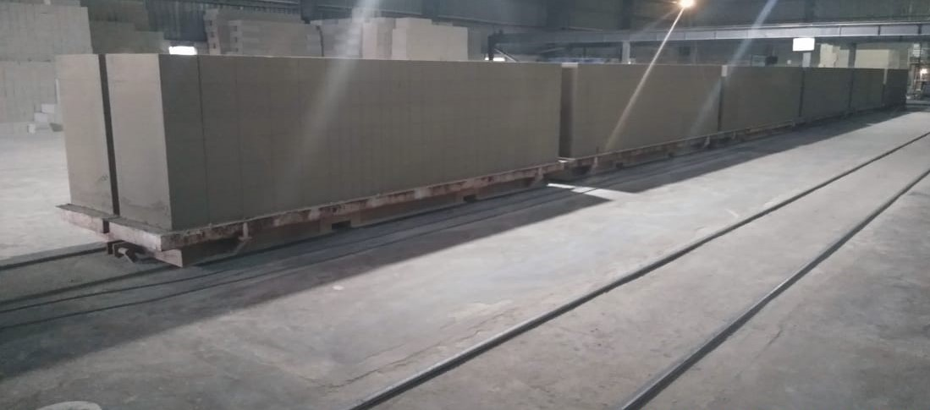
SNAP SHOTS

Slide 7
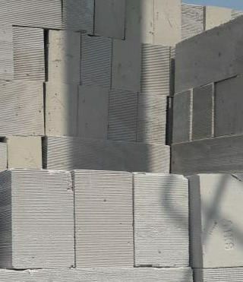
Thank You.
Padam Sharma
+91 9971299631
sgm@nsenergygroups.com
www.Monotech-engineers.com

