Slide 1



Monotech Engineers Pvt Ltd
(An ISO 9001:2015 Company)
PEB Building solutions

Slide 2


Group Introduction
The Monotech Engineers (P) Ltd. started in 2007, Corporate Address: A7/111 South Side GT Road Industrial Area, Ghaziabad-201009. It an integral part of “The NS Energy Group” which is a Conglomerate of upcoming professionally managed companies engaged in Design, Manufacture, EPC and O&M and PMC of Power Plants, PEB Buildings, EOT Cranes, EPC and turn key solutions of Biomass based power plants, Refurbishment and Overhauling of Steam and Gas Turbine since last two decades.
The N S Energy Group Comprises of:-
1. N S Thermal Energy (P) Ltd. www.nsthermalenergy.com
2. N S Terbo (P) Ltd. www.nsterbo.com
3. Monotech Engineers (P) Ltd. www.monotech-engineers.com
4. Mithila Dying and Chemical (P) Ltd. www.mdc-pl.com
5. Neeraj Gupta & Sons (P) Ltd www.ng-sons.com
2006 – Diversified in PEB Industry.

Slide 3
FACILITIES
PEB PLANT
        COVERED AREA = 20,000 SQFT
        CAPACITY = 5500 MT / ANNUM
SHEET ROLLING PLANT
        COVERED AREA = 22,000 SQFT
        CAPACITY = 4100 MT / ANNUM
PEB PLANT (NEW)
        COVERED AREA = 1,50,000 SQFT
        CAPACITY = 40,000 MT / ANNUM
TOTAL : -
        COVERED AREA = 1,92,000 SQFT
        CAPACITY = 49,600 MT / ANNUM

Slide 4
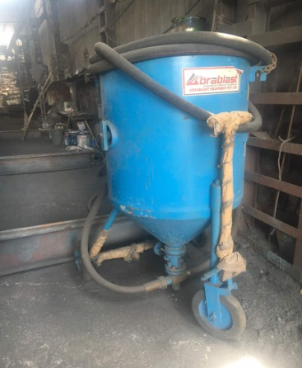
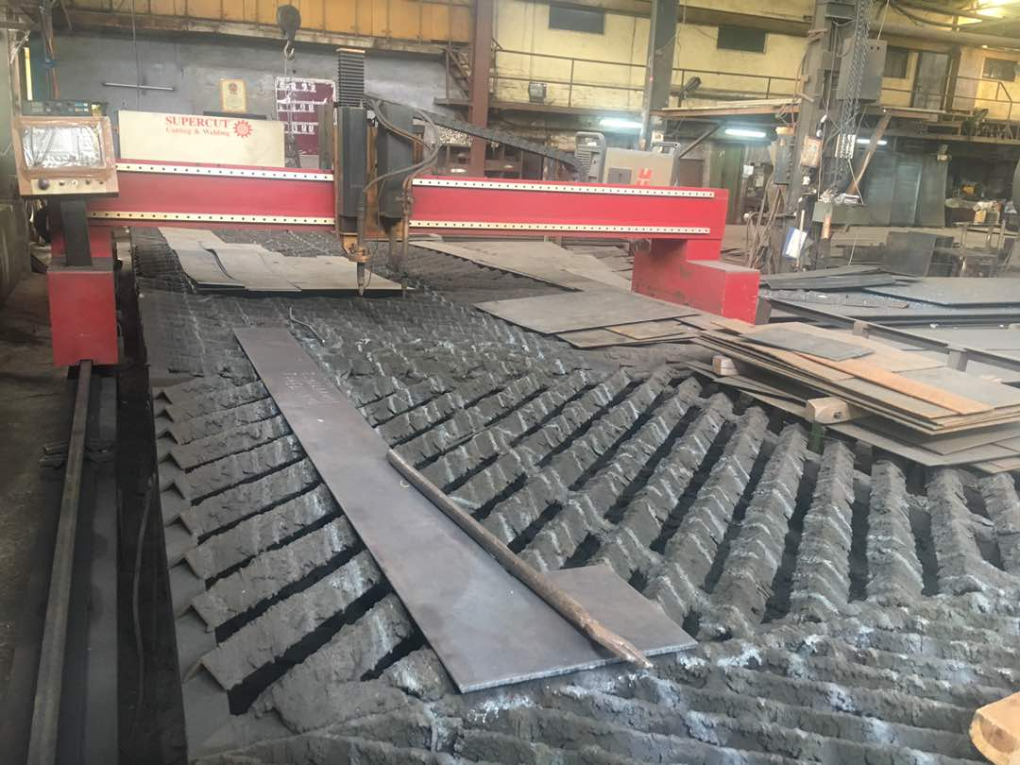
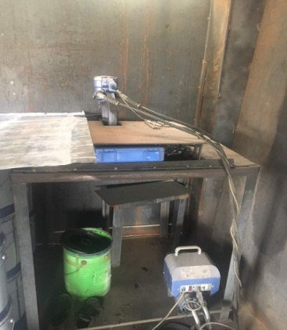
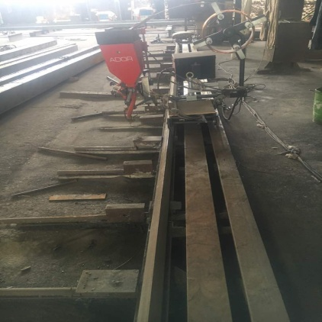
MAJOR MACHINERY – PLANT 1
NAME | MAKE | CAPACITY | LOCATION
CNC CUTTING M/C | HYPERTHERM USA. | UPTO 16 MM | PLANT-1
HYDRAULIC PUNCH M/C | NITTO | UPTO 16 MM | PLANT- 1
SAW WELDING M/C | ADOR | UPTO 15 M. | PLANT-1
SAND BLASTING M/C WITH COMPRESSOR | ARABLAST | CHAMBER FOR 15M | PLANT-1
AIR LESS PAINTING M/C | GRACO MAGNUM | 1 NOS. | PLANT-1

Slide 5
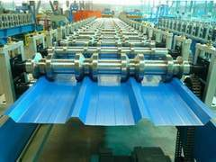
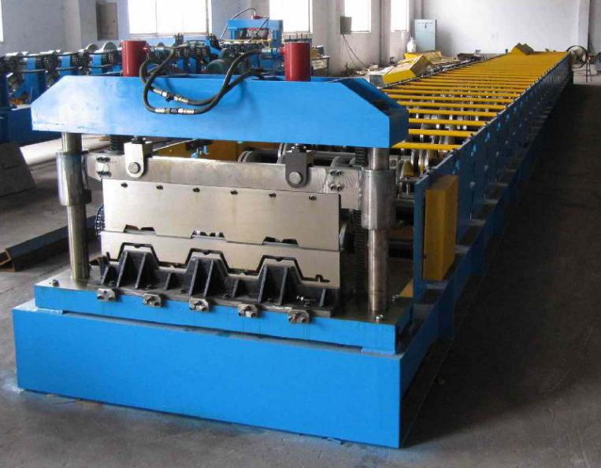
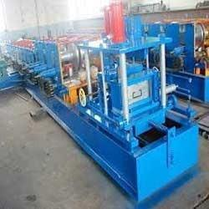
MAJOR MACHINERY – PLANT 2
NAME | MAKE | CAPACITY | LOCATION
ROLL FORMING MACHINE – DECK PROFILE | RAJKOT, GUJRAT | 21 STATION FOR FORMING DECK SHEET | PLANT-2
ROLL FORMING MACHINE –ROOF & SIDE, Hi- Rib PROFILE | RAJKOT, GUJRAT | 21 STATION FOR FORMING ROOF & SIDE SHEET | PLANT-2
C / Z INTERCHANGEABLE ROLLING M/C | CHINA | 10 STATION FOR FORMING ROOF & SIDE SHEET | PLANT-2

Slide 6
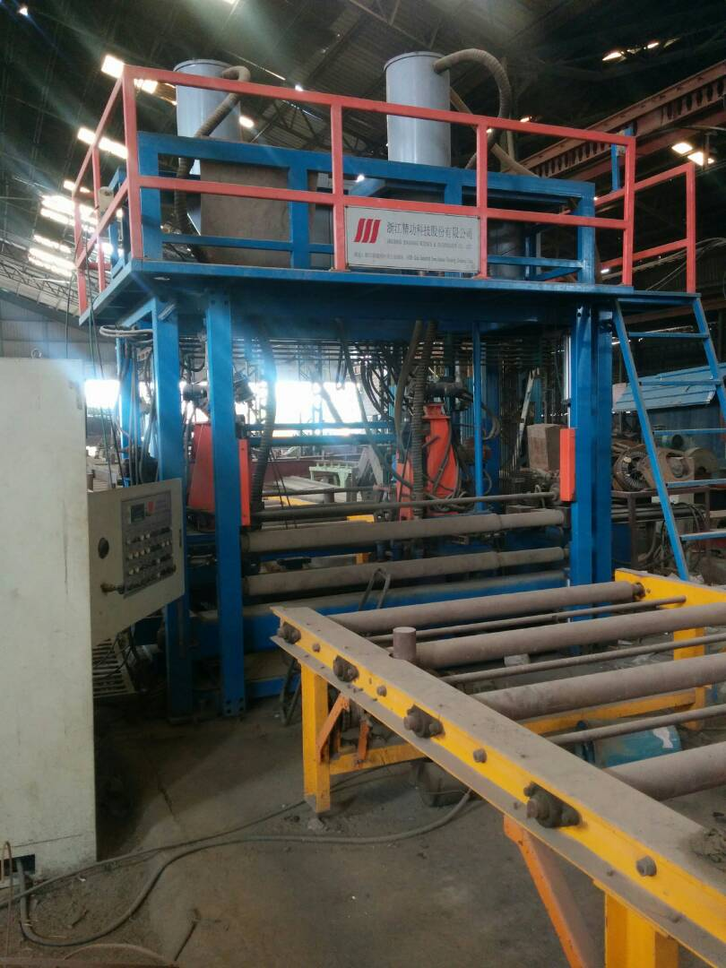
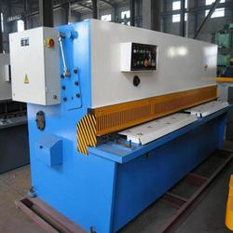
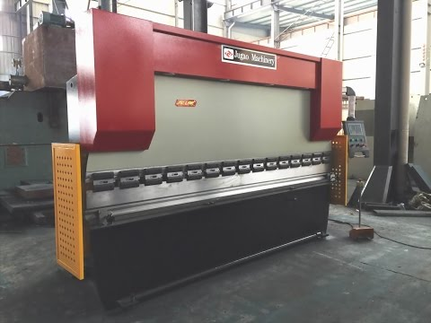
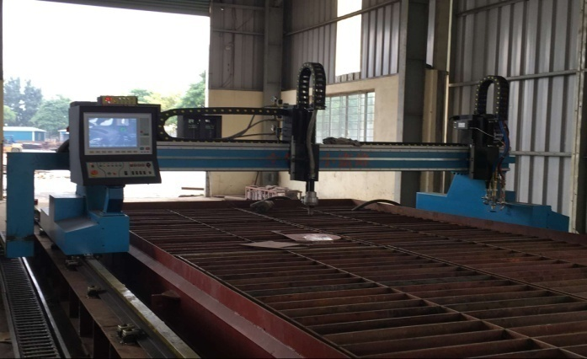
MAJOR MACHINERY – PLANT 3
NAME | MAKE | CAPACITY | LOCATION
H- BEAM LINE | CHINA | WITH 2000 MM WIDTH CAPACITY | PLANT-3
CNC CUTTING M/C | MESSER | UPTO 20 MM | PLANT-3
WATER JET CUTTING | SUPERCUT | UPTO 12 MM | PLANT-3
SHEARING M/C | MONOTECH | UPTO 5 MM | PLANT-3
BENDING M/C | MONOTECH | UPTO 5 MM | PLANT-3
PAINT SHOP – AIR LESS GUN | GRACO MAGNUM | 2 NOS. | PLANT-3

Slide 7
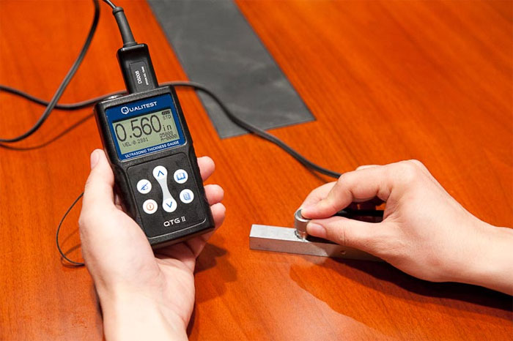
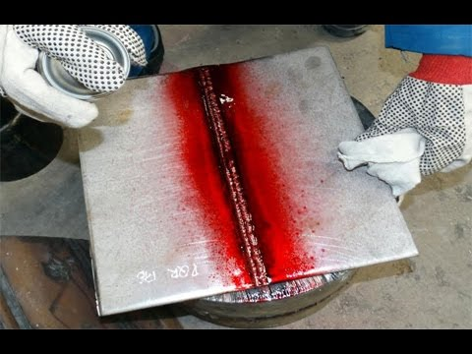
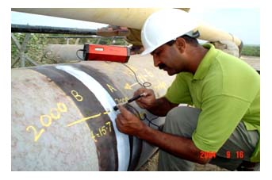
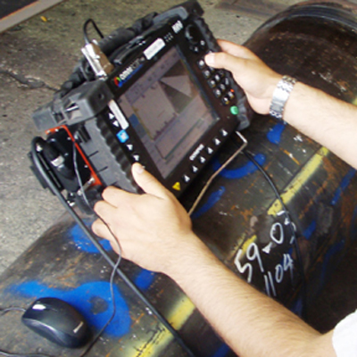
Regular Periodic Tests at Monotech
DP Test - Regularly
Radiography Test – Twice in a month
DFT / WFT Test – Regularly
UT Test - Twice in a month

Slide 8
REPORTS SYSTEM
Regular Reports Available
Dimension Report
DP Test Report
DFT Test Report
WFT Test Report
Radiography Report
UT Weld Report

Slide 9
MAJOR PROJECTS
1. Mangalayatan University, Aligarh – 2007 – Project Cost - 5.5Cr.
500 MT OF PROJECT - 7 BUILDINGS Including
CLASS-ROOM
CAFETERIA
AUDITORIUM ETC.
2. SPORTS COMPLEX – COMMON WEALTH (2010) – Project Cost – 4.0 Cr.
1200 MT OF PROJECT - Massive Sitting Arrangement / Indoor Stadium
Completed in 6 months
3. INDIRA GANDHI NATIONAL TRIBAL UNIVERSITY – INDIAN GOVT. – 2009-12 Project Cost - 80 Cr.
Turn Key Project with 2700 MT of Steel.
Total Project Ar. = 200 Acre
Building Description : -
  Main Campus Buildings
  Staff Quarters
  G + 2 Boys Hostel
  G + 2 Girls Hostel
  Completed Entire University Project In 36 Months

Slide 10
MAJOR PROJECTS
4. MKC FOOD PROCESSING PLANT – 2014 – Project Cost - 8.5 Cr.
Fully Automatic Food Processing Plant.
700 MT Of Project Project Area = 1,20,000 Sqft ( G+2 Building)
Completed In 5 Months
5. FOOD GODOWNS – BIHAR GOVT.– 2015 – 17 – Project Cost 18 Cr.
1100 MT Of various Projects. Total Project Area = 8,00,000 sqft
15 warehouses
6. Dr. Rajendra Prasad University - BIHAR.– 2016 – Project Cost 4.5 Cr.
Area 12000 Sq Ft. Turn Key Project.
7. Cadbury Warehouse & Food Processing – Project Cost – 8.0 Cr.
Turn Key Project – 300MT Steel
8. NIIT Technologies, GR. NOIDA – 2017 – Project Cost – 11 Cr.
Turn Key Project – 200MT Steel

Slide 11
Thank You
For More Details Please contact
Padam Sharma
Mobile No. 9971299631
Email: sgm@nsenergygroups.com
Corporate Address:
S-16,South Side, G.T. Road, Industrial Area, Ghaziabad, Uttar Pradesh -201009, INDIA
Tele: +(91)-8081918191,+91-120-4246515/4115321
Mob: +91-9350040636, 09313429301
URL: www.nsenergygroups.com

