Slide 1


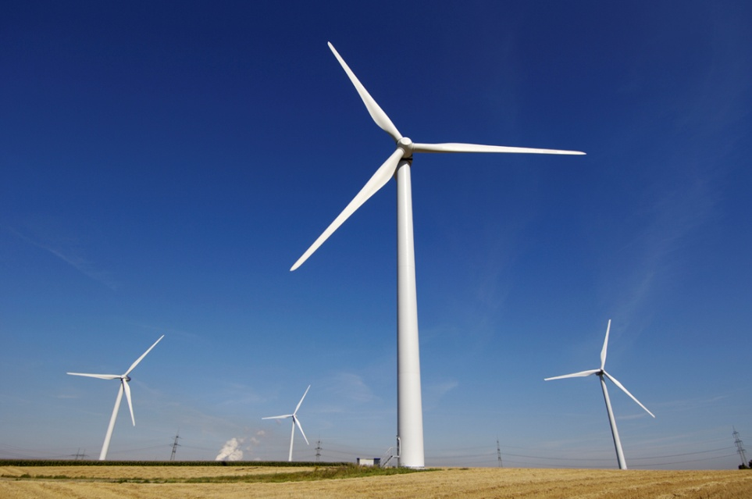
N S ENERGY WINDMILL SOLUTION
Vision
To ensure total customer satisfaction through cost effective Technology
Safety of Men and Machine on Superior Priority
AMIGOCONNECT

Slide 2
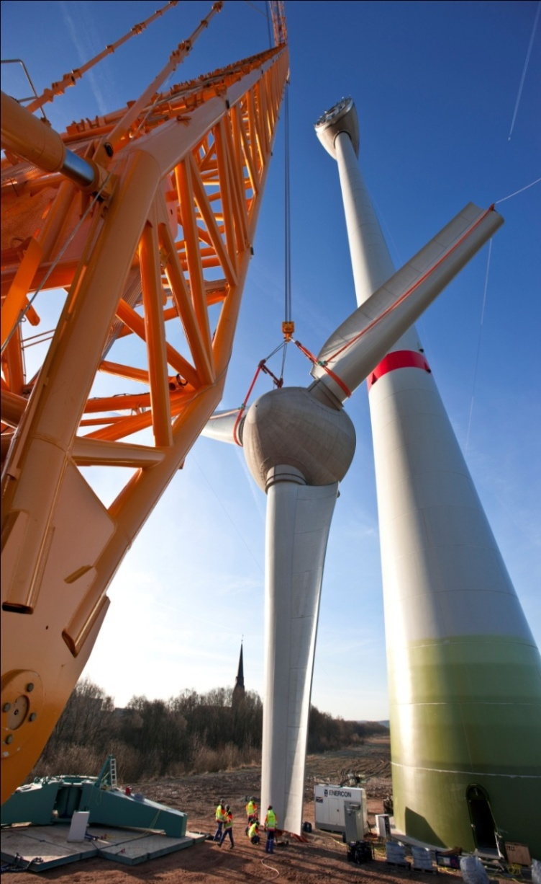
AMIGOCONNECT
VISION
To BE the worlds leading supplier of services and solutions to realize complete wind park projects in the safest and most economical way possible by using technically sophisticated, first class equipment and highly skilled and dedicated work force.

Slide 3
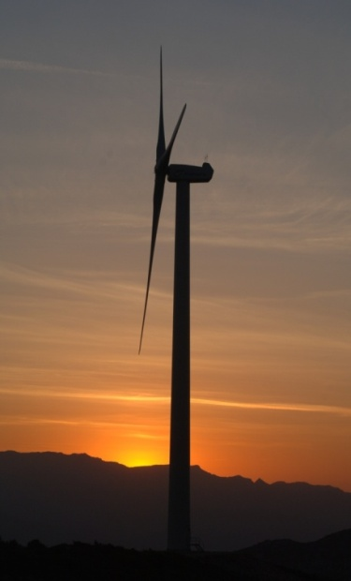
AMIGO CONNECT
Group Introduction
The Monotech Engineers (P) Ltd. started in 2007, Corporate Address: A7/111 South Side GT Road Industrial Area, Ghaziabad-201009. It an integral part of “The NS Energy Group” which is a Conglomerate of upcoming professionally managed companies engaged in Design, Manufacture, EPC and O&M and PMC of Wind Park, Biomass Power Plants (Up-to 10 MW), PEB Buildings, EOT Cranes, EPC and turn key solutions of Biomass based power plants, Refurbishment and Overhauling of Steam and Gas Turbine since last two decades.
The N S Energy Group Comprises of:-
1. N S Thermal Energy (P) Ltd. www.nsthermalenergy.com
2. N S Terbo (P) Ltd. www.nsterbo.com
3. Monotech Engineers (P) Ltd. www.monotech-engineers.com
4. Mithila Dying and Chemical (P) Ltd. www.mdc-pl.com
5. Neeraj Gupta & Sons (P) Ltd www.ng-sons.com
2006 – Diversified in PEB Industry.

Slide 4
AMIGOCONNECT
CUSTOMERS BENEFITS
  Single point of contact for all required services.
  Extensive knowledge of the wind turbine erection and rich experience.
  Highest safety level on-site.
  We are an Indian registered company to facilitate work in India with engineering back-up from our JV specialized in WTG EPC and Turnkey Erection.
  Adequate Nos. of hyd. axles/ strand jacks/tower mast and sliding gantry.
  Specialized and trained man power

Slide 5
AMIGOCONNECT
Our complete turnkey solutions for wind energy sector include:
1. Service available all over India.
2. Dismantling & Erection with latest technology
3. Operation & Maintenance of WTG
4. Blade repairs, cleaning, Vortex Generators
5. Re-engineering / Re Powering & Consultancy
Project Solutions
❖ Mechanical Electrical Installations ❖ EPC contracting ❖ Site Management
❖ Project Management ❖ Crane Rental

Slide 6
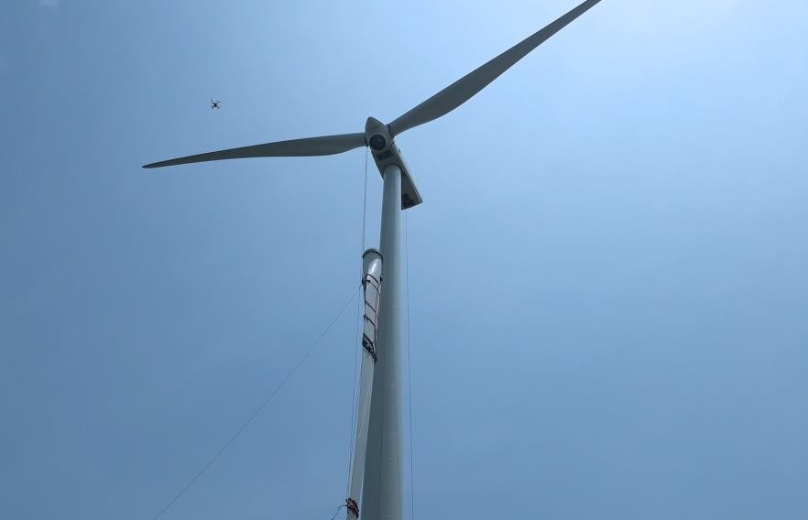
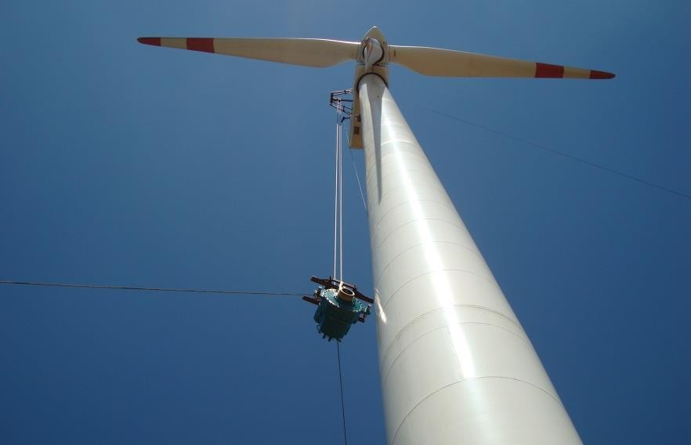
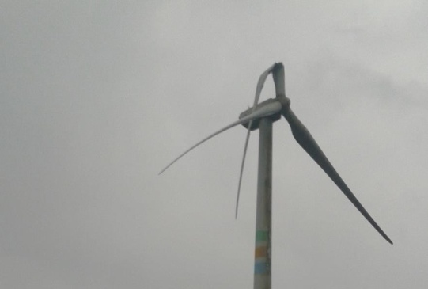
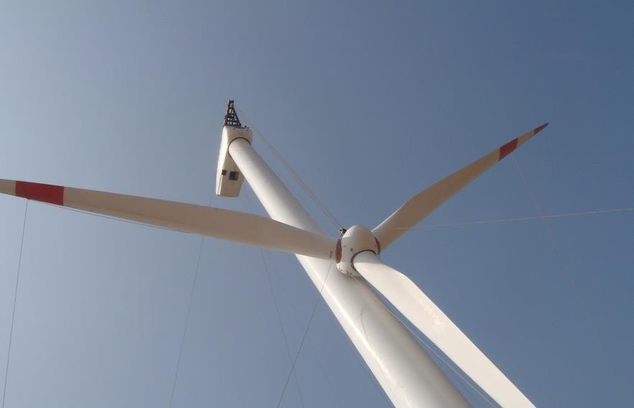
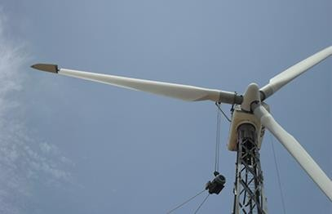
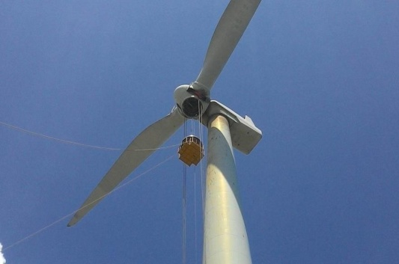
AMIGOCONNECT
Large correctives by N S Energy
Single Blade Replacement
Unbalanced
Rotor Replacement
Gear Box Replacement
Rotor Replacement
Generator Replacement
Blade Pitch
Bearing Replacement

Slide 7
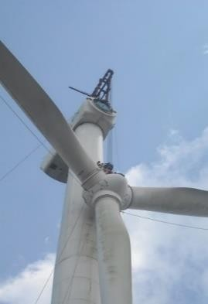
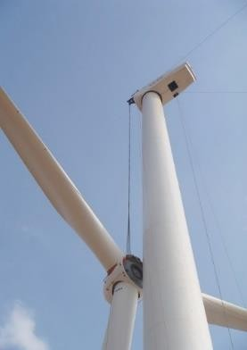
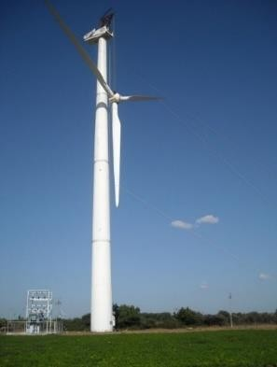
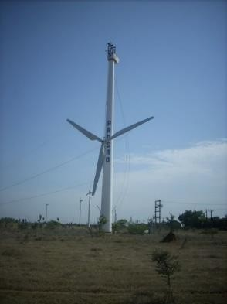
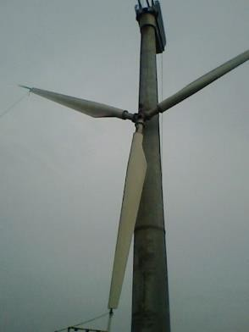

AMIGOCONNECT
Rotor Replacement
Suzlon 1.5 MW
Suzlon 1.25 MW
NEPC 750 KW
AMTL 250 KW
NEPC 225 KW
Weight : 35 ton
Weight : 25 ton
Weight : 16 ton
Weight : 6 ton
Weight : 5.5 ton

Slide 8
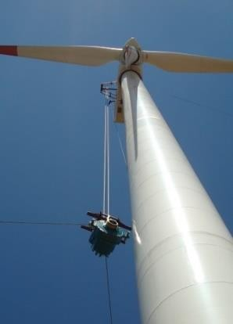
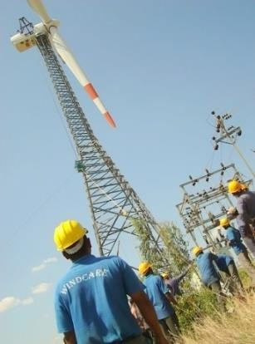
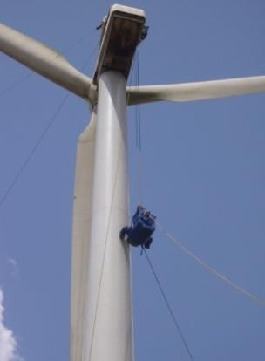
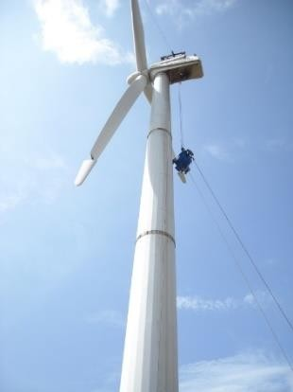
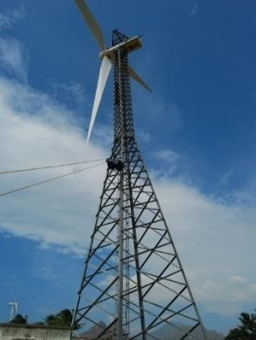
AMIGOCONNECT
Gear Box Replacement
Suzlon, 1.5 MW
Suzlon, 1.25MW
NEG-Micon, 950 KW
NEG-Micon, 750 KW
RRB, 500 KW
Weight : 15 ton
Weight : 10 ton
Weight : 7.5 ton
Weight : 7 ton
Weight : 6 ton

Slide 9
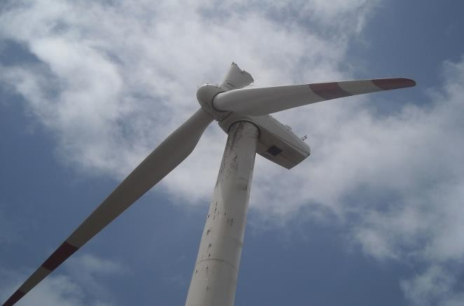
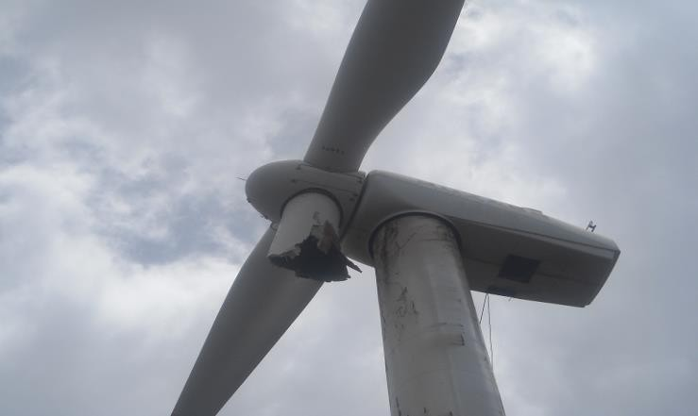
Unbalanced Rotor
AMIGOCONNECT
BEFORE ROTATION
AFTER ROTATION

Slide 10
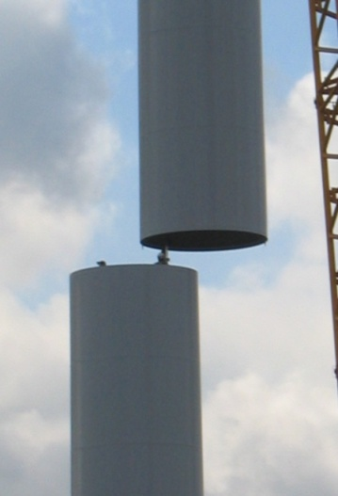
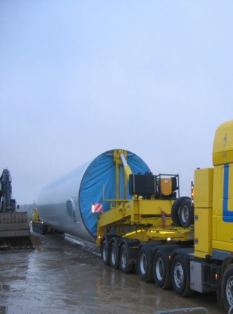
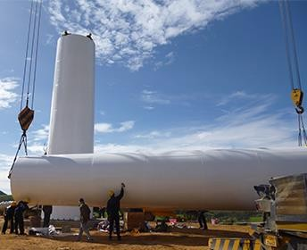
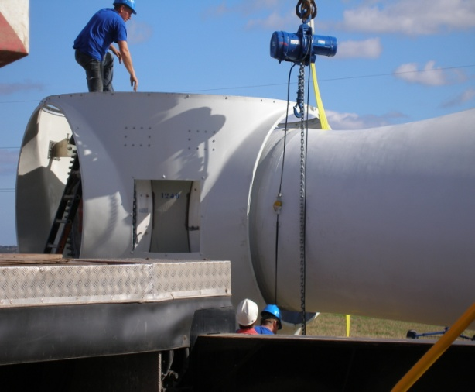
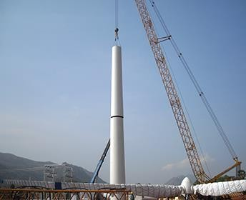
AMIGOCONNECT
Tower & Nacelle
We possess all equipment for assembling and erection works like;
❖ Complete Tools & Tackles
❖ Calibrated torque wrenches
❖ Hydraulic Torque units
❖ Lifting equipment
❖ Crane supply
❖ Alignment equipment etc.

Slide 11
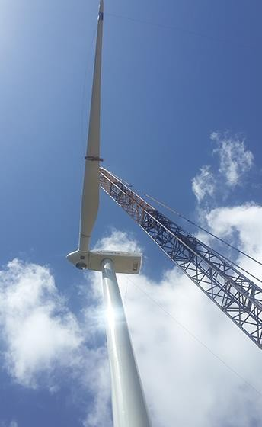
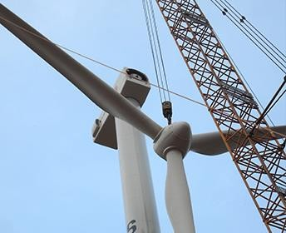
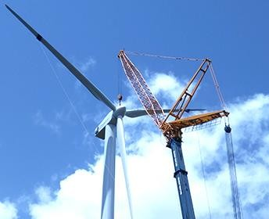
AMIGOCONNECT
Blades & Rotor
❖ Assembly and erection of Blade & Rotor unit
❖ Single blade erection using ‘C’ clamp method

Slide 12
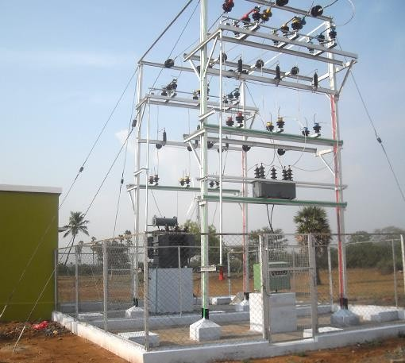
AMIGOCONNECT
Electrical Installation
❖ Unit sub station construction
❖ External & Internal on line works
❖ VCB & switching yard installation
❖ Sub station construction, bay extension
works
❖ Pre commissioning of turbines

Slide 13
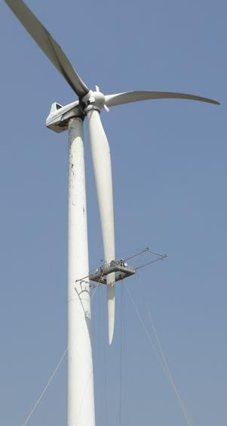
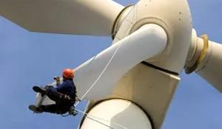
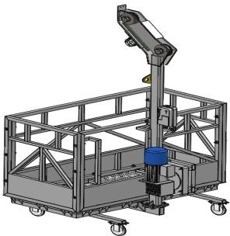
AMIGOCONNECT
Operation & Maintenance
Blade Inspection, Repairs, Cleaning, Painting And Vortex Generators.
Indigenously designed, CE approved Blade platforms
All kind of blade inspections
We have made a separate entity for all kind of blade
inspection, Maintenance, repairs, retrofits etc.
In discussion for Collaboration with a MNC Company for vortex generator design, supply and fixing in any model and type of blades.
Cleaning, painting and coating of Blades.

Slide 14
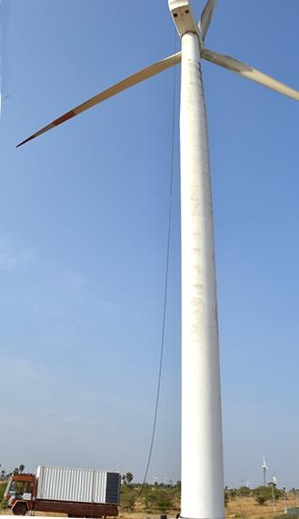
AMIGOCONNECT
Operation & Maintenance
Gear Oil Replacement
Wind Turbine manufacturers and maintenance companies are quickly realizing the benefits of the Gear Oil Exchange System.
Benefits:
Use of on-board filtration system that filters new oil to ISO-approved levels.
Fresh oil is heated for easier flow.
Vacuuming new oil directly from a bulk tote or barrel.
Enhancements include flush capabilities and/or rinse capabilities.
Adopts PLC control and totally-enclosed design.
Has the functions of heating, flushing and on-line monitoring that helps ensure the efficiency and safety of oil changing.
Highlights:
Motorized gear oil pumps for oil replacements
More replacements in a day and reducing down time of turbines.

Slide 15
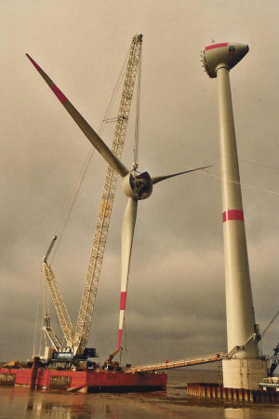
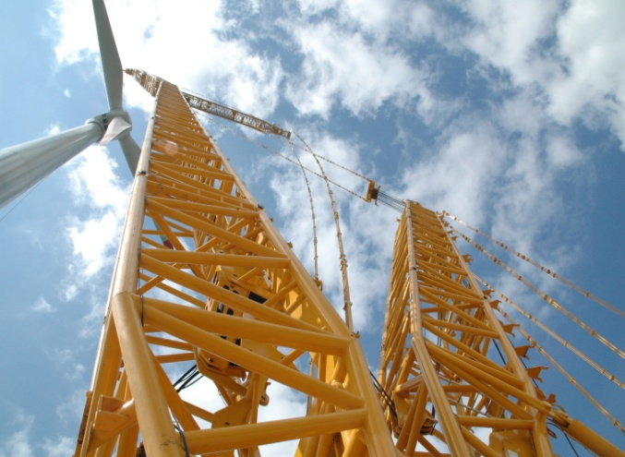
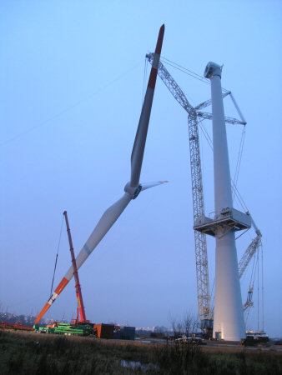
AMIGOCONNECT
Cranes frequently used in wind mill erection
1.Demag TC – 2800
2.Demag TC – 2800/1
3.Demag CC – 2800/1
4.LiebherrLG – 1500
5.Liebherr LR – 1400
6.Liebherr LR – 1400/2
7.Sany SCC – 2500

Slide 16
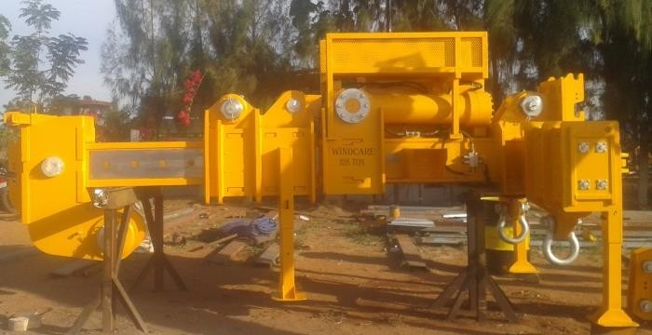
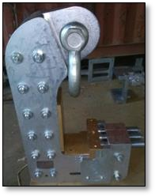
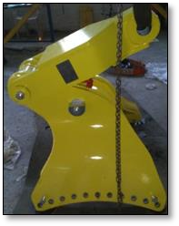
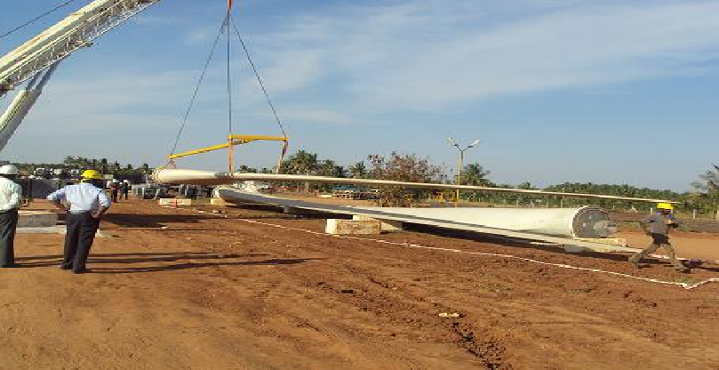
AMIGOCONNECT
TOOLS AVAILABLE
Nacelle Lifting Jig
Tower lifting jig
Rotor lifting jig
Blade T – Frame for 850 KW

Slide 17






Erected more then 1000 wind turbines in India
Total installed power over 1500mw
Supplier to all major (and small) wind turbine manufactures.
AMIGOCONNECT
REFERNCES

Slide 18
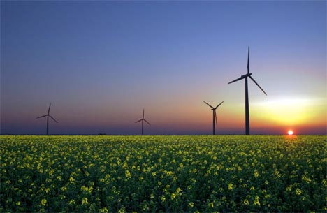
AMIGOCONNECT
For More Details Please contact
Padam Sharma
Mobile No. 9971299631
Email: sgm@nsenergygroups.com; monotech@nsenergygroups.com
Corporate Address:
S-16,South Side, G.T. Road, Industrial Area, Ghaziabad, Uttar Pradesh -201009, INDIA
Tele: +(91)-8081918191,+91-120-4246515/4115321
Mob: +91-9350040636, 09313429301
URL: www.nsenergygroups.com

